Slide 1
JS5: Lesson #10

Slide 2
Agenda
JavaScript in Browser
Events Handling

Slide 3
JavaScript in Browser

Slide 4
What is DHTML?
DHTML is NOT a language.
HTML
JavaScript
DOM
CSS
DHTML

Slide 5
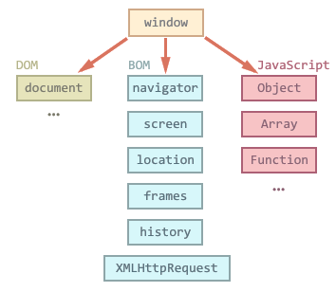
JavaScript in Browser

Slide 6
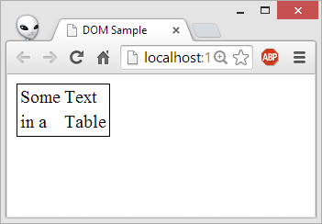
JavaScript in Browser
<html>
<body>
document
<table>
<tbody>
<tr>
<td>
Some
<td>
<tr>
<td>
Text
in a
<td>
Table
<head>
<title>
DOM Sample
<style>
table {…
<!DOCTYPE html>
<html>
<head>
<title>DOM Sample</title>
<style type="text/css">
table {
border: 1px solid black;
}
</style>
</head>
<body>
<table>
<tbody>
<tr>
<td>Some</td>
<td>Text</td>
</tr>
<tr>
<td>in a</td>
<td>Table</td>
</tr>
</tbody>
</table>
</body>
</html>
window
DOM

Slide 7
What DOM Defines?
The events for all HTML elements
The methods to access all HTML elements
The properties of all HTML elements
All HTML elements as objects

Slide 8
Manipulating DOM with JavaScript

Slide 9
Finding Elements
Finding HTML elements by id
Finding HTML elements by tag name
Finding HTML elements by class name
Finding HTML Elements by CSS Selector

Slide 10
Finding HTML Elements by id
var t = document.getElementById('target');
Will find one element with id "target"
<!DOCTYPE html>
<html>
<head>
</head>
<body>
<p id="target">Sample Target</p>
<p>Another Paragraph</p>
</body>
</html>

Slide 11
Finding HTML Elements by Tag Name
var p = document.getElementsByTagName('p');
Will find all paragraphs on a page
<!DOCTYPE html>
<html>
<head>
</head>
<body>
<p id="target">Sample Target</p>
<p>Another Paragraph</p>
</body>
</html>

Slide 12
Finding HTML Elements by Class Name
var p = document.getElementsByClassName('target');
Will find all elements with class 'target' on a page
<!DOCTYPE html>
<html>
<head>
</head>
<body>
<p class="target">Sample Target</p>
<p class="target">Another Paragraph</p>
</body>
</html>

Slide 13
Finding HTML Elements by CSS Selector
var t = document.querySelector('body > p#target');
Will find one element by CSS selector "body > p#target"
<!DOCTYPE html>
<html>
<head>
</head>
<body>
<p id="target">Sample Target</p>
<p>Another Paragraph</p>
</body>
</html>

Slide 14
Changing HTML
Changing HTML content
Changing the Value of an Attribute
Changing HTML Style

Slide 15
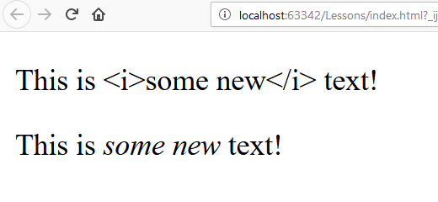
Changing HTML Content
Will replace inner content of an element
<body> <p id="p-1"></p> <p id="p-2"></p> <script> var p1 = document.getElementById('p-1'); p1.textContent = 'This is <i>some new</i> text!'; var p2 = document.getElementById('p-2'); p2.innerHTML = 'This is <i>some new</i> text!'; </script> </body>

Slide 16
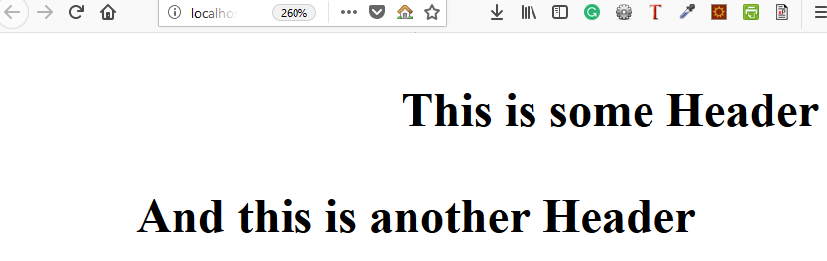
Changing the Value of an Attribute
document.getElementById(id).attribute = New value
<body> <h3>This is some Header</h3> <h3>And this is another Header</h3> <script> var h3 = document.getElementsByTagName('h3');
h3[0].align = 'right'; h3[1].align = 'center'; </script> </body>

Slide 17
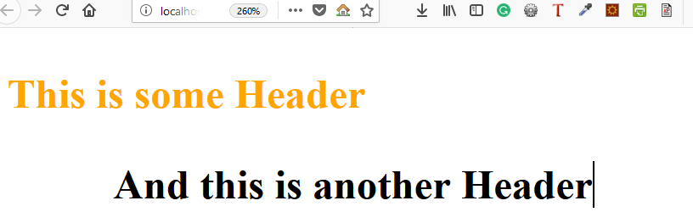
Changing HTML Style
document.getElementById(id).style.property = New value
<body> <h3 class="header">This is some Header</h3> <h3 class="header">And this is another Header</h3> <script> var header = document.getElementsByClassName('header'); header[0].style.color = 'orange'; header[1].style.textAlign = 'center'; </script> </body>

Slide 18
Adding and Removing HTML
Creating New HTML Elements
Inserting HTML Elements
Removing HTML Elements

Slide 19
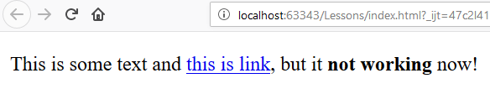
Creating New HTML Elements (Nodes)
Before adding new element to the HTML DOM, you must create the element (element node) first.
<body> <p id="p-1"></p> <script> var link = document.createElement('a'); var text = document.createTextNode('this is link'); link.appendChild(text); link.href = '#'; var paragraph = document.getElementById('p-1'); paragraph.textContent = 'This is some text and '; paragraph.appendChild(link); paragraph.innerHTML += ', but it <b>not working</b> now!'; </script> </body>

Slide 20
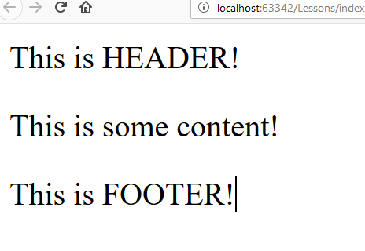
Inserting Elements Before and After Node
Also, you can inserting HTML Elements before and after another element (element node).
<body> <div id="content">This is some content!</div> <script> var header = document.createElement('header'); var footer = document.createElement('footer'); header.textContent = 'This is HEADER!'; footer.textContent = 'This is FOOTER!'; var content = document.getElementById('content'); var body = document.getElementsByTagName('body')[0]; body.insertBefore(header, content); body.appendChild(footer); </script> </body>

Slide 21
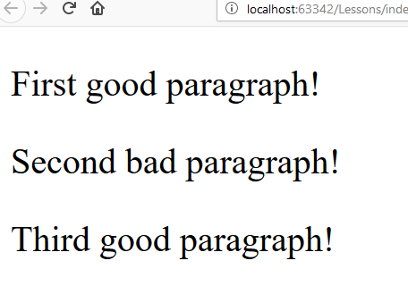
Removing Existing HTML Elements
<body> <div id="container"> <p>First good paragraph!</p> <p>Second bad paragraph!</p> <p>Third good paragraph!</p> </div> </body>
To remove an HTML element, you must know the parent of the element.

Slide 22
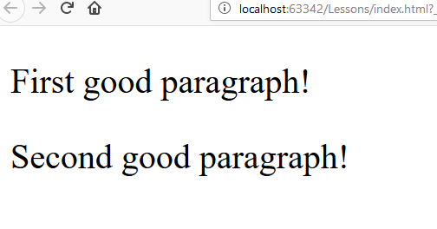
Removing Existing HTML Elements
<body> <div id="container"> <p>First good paragraph!</p> <p>Second bad paragraph!</p> <p>Third good paragraph!</p> </div> <script> var container = document.getElementById('container'); var paragraphs = document.getElementsByTagName('p'); container.removeChild(paragraphs[1]); var newParagraph = document.createElement('p'); newParagraph.textContent = 'Second good paragraph!'; container.replaceChild(newParagraph, paragraphs[1]); </script> </body>
https://codepen.io/mdem/pen/EvWoNM

Slide 23
JavaScript Popups
Alert Box
Confirm Box
Prompt Box
alert("alert text");
confirm("confirm text"); // return Boolean type
/* If the user clicks "OK" the box returns the
input value. If the user clicks "Cancel" the
box returns null. */ prompt("prompt text","defaultvalue");

Slide 24
Events Handling

Slide 25






Description
How JavaScript communicates with the world?
In outline a mechanism works by next scenario: user do something and this action be an event for browser. JavaScript observe for pages in browser. And if event has occurred script be activated.

Slide 26
Event handling
But JavaScript doesn't observe for events by default.
You should specify for your code what events interesting for it.
Exist 3 base ways to subscribe on event:
inline in HTML;
using of onevent attribute;
using of special methods.
First and second ways are deprecated for present days. Let's see more detailed on event handling.

Slide 27
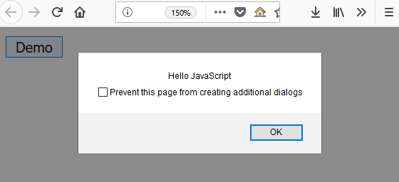
Inline handling
The Inline way adding of JavaScript into HTML.
If we use this technique we should update HTML-page and set some JS code in onevent attribute of HTML-element.
Example:
<button onclick = “action();”>
Demo
</button>
<button onclick="alert('Hello JavaScript');">Demo</button>
Note: never use this way, because it impacted on HTML and JavaScript simultaneously. So let's search next solution!

Slide 28
Using of onevent attribute
For adding event handler in this way you should find object that represents JavaScript model of HTML-element.
For example, your button have id btn:
<button id = “btn”> Demo </button>
Then desired object will be created automatically. Next you can use property onclick:
btn.onclick = action;
Where action it’s a some function defined like:
function action () { . . . }

Slide 29
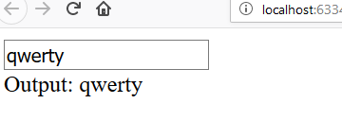
Using of onevent attribute
Example #1:
Example #2:
button id="btn">Demo</button> <script> btn.onclick = function () { alert('Hello JavaScript'); } </script>
<input type="text" id="input"><br> Output: <span id="output"></span> <script> var input = document.getElementById('input'); var output = document.getElementById('output'); input.onkeyup = function () { output.textContent = input.value; } </script>

Slide 30
Proper ways
Previous way make sense, but have some limitation.
For example you can’t to use more than one handler for one event, because you set function on onevent attribute directly.
Next method help you subscribe to any event:
btn.addEventListener(“click”, action, false);
Moreover, you can unsubscribe from any event:
btn.removeEventListener(“click”, action);

Slide 31
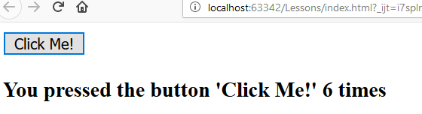
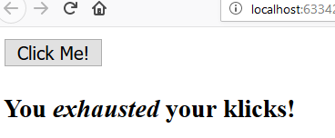
Proper ways
<button id="klicker">Click Me!</button> <h3 id="click-info">You pressed the button 'Click Me!'
<span id="click-times">0</span>
times</h3> <script> var count = 1; var clickTimes = document.getElementById("click-times"); var clickInfo = document.getElementById("click-info"); var klicker = document.getElementById("klicker"); function handler() { clickTimes.textContent = count; if(count == 10) { klicker.removeEventListener("click", handler); clickInfo.innerHTML = "You <i>exhausted</i> your klicks!"; } count++; } klicker.addEventListener("click", handler); </script>

Slide 32
Bubbling and Capturing
Third parameter of addEventListener it's a phase of event processing. Exist 2 phases:
bubbling (if parameter is "false") – by default
capturing (if parameter is "true").
For example:
exist three nested elements <red>, <green> and <blue> (<div> or something else). When event has occurred on inside element <blue> it processing started from top of DOM: window and follow to target element. After processing in target element event will going back.
<red>
<green>
<blue />
</green>
</red>

Slide 33
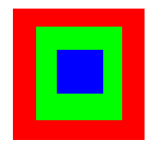

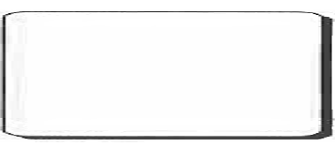
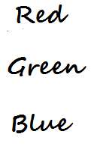

Bubbling and Capturing
<red>
<green>
<blue />
</green>
</red>
https://codepen.io/mdem/pen/gwaVkN
Bubbling
Capturing

Slide 34
Event object
For every event in browser will be created instance of Event object.
You can take it if you need. In W3C browsers this object will be passed as a first parameter of event handler:
btn.addEventListener(“click”, action, false);
Where action was defined like:
function action (e) { ... }

Slide 35

Control of Default behavior
Sometimes default scenario of event processing include some additional behavior: bubbling and capturing or displaying of context menu, for example.
If you don't need a default behavior you can cancel it. Use for it event object and next methods:
e.preventDefault();
for aborting of default browser behavior.
.
e.stopPropagation();
for discarding of bubbling and capturing.
https://codepen.io/mdem/pen/EeQVgj

Slide 36
Contacts
Europe Headquarters
52 V. Velykoho Str.
Lviv 79053, Ukraine
Tel: +380-32-240-9090 Fax: +380-32-240-9080
E-mail: info@softserveinc.com
Website: www.softserveinc.com
US Headquarters
12800 University Drive, Suite 250 Fort Myers, FL 33907, USA
Tel: 239-690-3111 Fax: 239-690-3116
Thank You!
Copyright © 2010 SoftServe, Inc.

